Slide 1

Project Title – Seasonal Agricultural Performance Analysis
[Student Name- Sameer Kumar Sachdev
College Name- New Delhi Institute Of Management ]
AICTE STU ID : (STU68732630818f51752376880)

Slide 2

PROBLEM STATEMENT
Agricultural activities are influenced by seasonal variations in environmental conditions, farming practices, resource availability and market conditions. As a result, agricultural performance may differ from one season to another. However, raw agricultural data does not clearly explain how agricultural performance changes across seasons or what patterns can be observed in different seasonal conditions. The problem is to analyze the given agricultural dataset and investigate seasonal differences in agricultural performance by identifying meaningful patterns, trends, relationships and variations within the available data.

Slide 3
Project Description: To investigate how agricultural performance varies across seasons and identify meaningful patterns, trends, relationships, and differences within the data — ultimately translating statistical findings into practical recommendations for farmers and policymakers.

Slide 4

WHO ARE THE END USERS?
The potential end users may involve:-
Students and Data Analytics Learners – They can use this project as an example to learn more about data cleaning , analysis , visualisation and preparing useful insights
Researchers and Analysts- Researchers and Data Analysts can also use this data to identify any trends , patterns and other useful relationships which may help them to generate potential insights and On the basis of that Businesses, Stakeholders and other members can take important decisions.
Farmers- This analysis may also helps farmers to understand how agricultural performance changes across different seasons. What might be the potential impacts what measures need to be taken to tackle any unexpected events or uncertainties.

Slide 5

Technology Used
In this project I have used the following technologies :-
Google Colab- I have used this tool for the complete data analysis.
Python- In this project it is used as the primary programming language for data cleaning, analysis and processing.
Pandas- It is used for data manipulation, cleaning and analysis.
Numpy- It is used for numerical calculations and operations.
Matplotlib- It is used for creating meaningful charts and visuals.
Seaborn – It is used for advanced statistical and exploratory data visualisations.

Slide 6
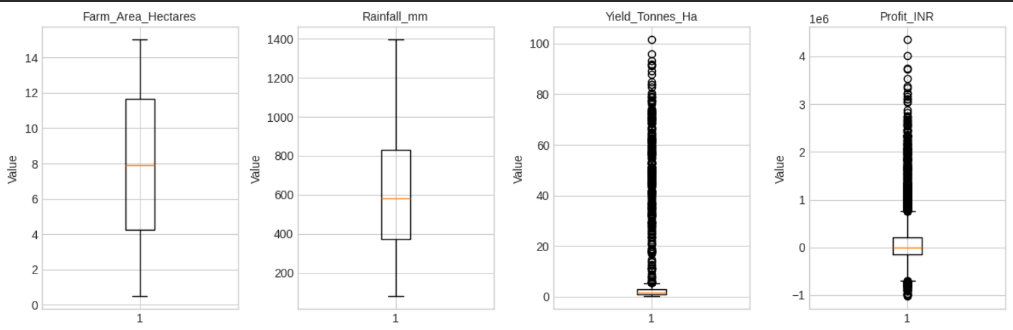
RESULTS
Distribution & Outliers Overview Farm area and rainfall show fairly normal, well-behaved spreads, but yield and profit are heavily right-skewed with a large number of extreme outliers. This suggests a small subset of farms (likely high-yield crops like sugarcane) are pulling the averages up significantly.

Slide 7
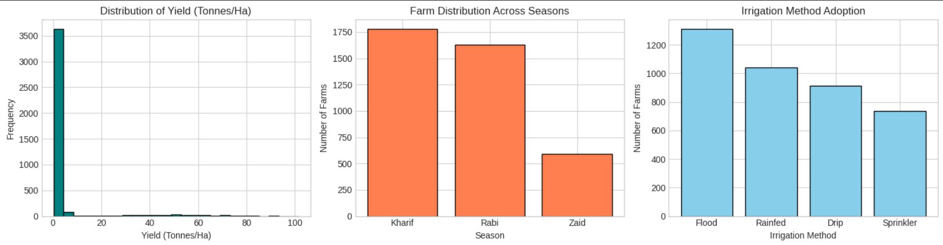
RESULTS
Yield, Season & Irrigation Distribution Most farms cluster at very low yield values, with only a handful reaching extreme highs, confirming the skew seen in Image 1. Kharif is the dominant season by farm count, and flood irrigation remains the most widely adopted method despite being the least water-efficient.

Slide 8
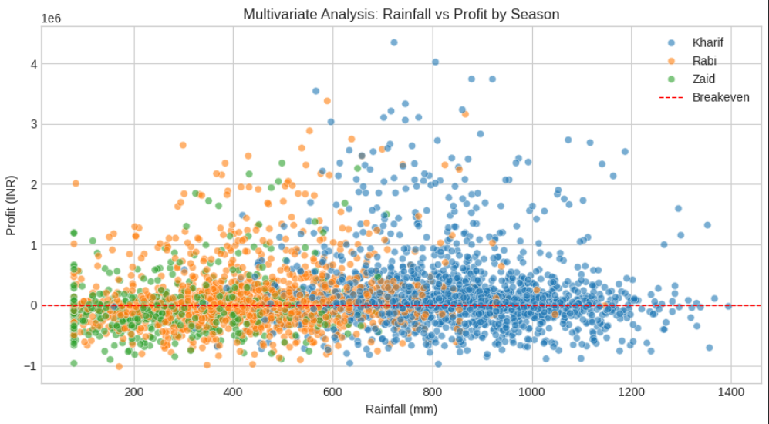
RESULTS
Rainfall vs Profit by Season Profit shows no strong linear relationship with rainfall, though Kharif farms (blue) dominate the higher rainfall range and achieve some of the highest profits. Rabi and Zaid farms are concentrated in lower rainfall zones with more modest, tightly-packed profit values.

Slide 9
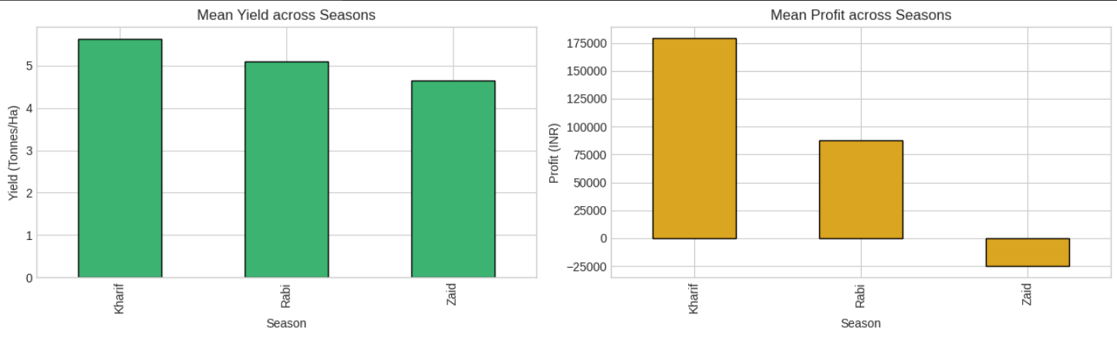
RESULTS
Mean Yield & Profit Across Seasons Kharif leads in both average yield and profit, followed by Rabi, while Zaid lags on yield and actually shows a negative average profit. This indicates Zaid-season farming may currently be unprofitable on average and warrants further investigation.

Slide 10
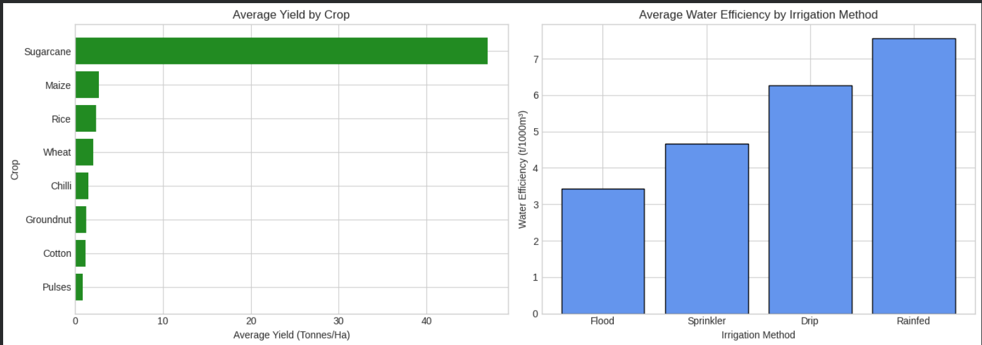
RESULTS
Crop Yield & Irrigation Efficiency Sugarcane massively outperforms all other crops in yield, explaining much of the skew and outliers noted earlier. On the irrigation side, rainfed methods show the highest water efficiency, while flood irrigation is the least efficient despite being most commonly used — a clear opportunity for improvement.

Slide 11
Future scope
The project can be expanded by using real-time and larger agricultural datasets from different regions.
Additional factors such as market prices, weather forecasts, and government policies can be included for deeper analysis.
Machine Learning models can be used in the future to predict crop yield and agricultural performance.
The analysis can be developed into an interactive dashboard using Power BI or Tableau for easier decision-making.
Future studies can compare agricultural performance across different crops, regions, and years.
The findings can be used to support better seasonal planning, resource management, and farming decisions.

Slide 12
GitHub Link
https://github.com/sameer-sachdev/Seasonal-Agriculture-Performance-Analysis

Slide 13
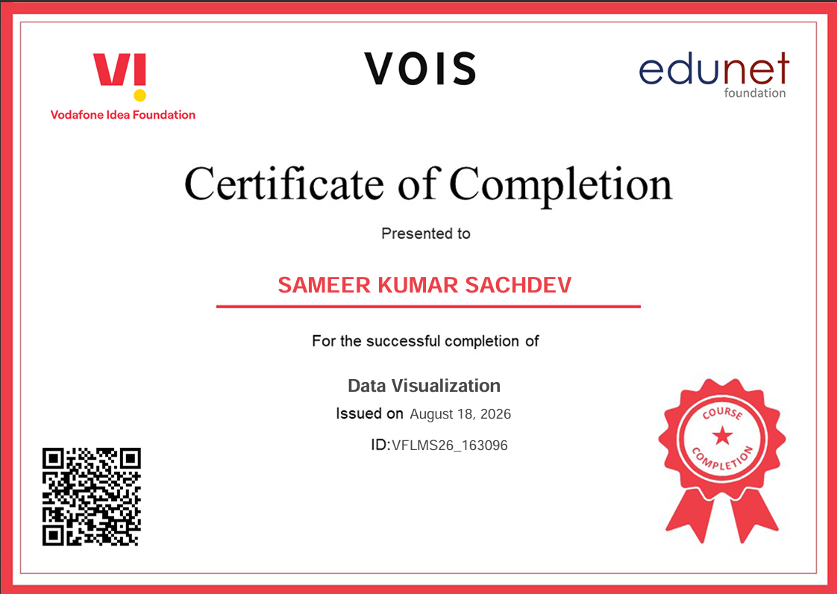
VOIS Course completion certificate - Course name- Data Visualization

Slide 14
Thank you
.
.

